Slide 1

Short Course Material
Introduction to Full-Stack JavaScript Framework

Slide 2
Web application with the MEN Stack

Slide 3

MEN Stack
MEN – MongoDB + Express + Node
MongoDB – The standard NoSQL database
Express – The default web applications framework
Node.js – Framework used for scalable server-side and networking applications.
Web application framework

Slide 4
MEN Stack
Creating a Express web application project
package.json
"scripts": {
"build": "tsc --project ./tsconfig.json",
"start": "node ./build/app.js"
},
"devDependencies": {
"tslint": "^6.1.3",
"typescript": "^4.3.5",
"@types/express": "^4.17.13"
},
"dependencies": {
"express": "^4.17.1"
}
npm init
npm i -D typescript tslint
npm i express

Slide 5
MEN Stack
tsconfig.json breakdown
{
"compilerOptions": {
"module": "ES6",
"strict": true,
"noImplicitAny": true,
"removeComments": true,
"sourceMap": true,
"outDir": "./build",
"moduleResolution": "node",
"allowSyntheticDefaultImports": true
},
"files": [ "./App.ts" ]
}
Ensure code generation supported by Node
Recommended for typescript. Fix unresolved module issues
not require to “Import * from …”

Slide 6
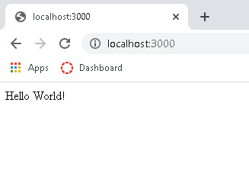
MEN Stack
Sample Express Application
import express from 'express'
var app = express();
app.get('/', function (req, res) {
res.send('Hello World!');
});
var port = 3000
console.log(`Application running at ${port}`)
app.listen(port);

Slide 7
MEN Stack – Demo
DEMO
P2

Slide 8
MEN Stack
Express routing
HTTP methods:
app.get (`url`, (request, response) => …)
app.post (`url`, (request, response) => …)
app.put (`url`, (request, response) => …)
app.delete (`url`, (request, response) => …)
URL path can contain parameters like React Router ('/user/:id')

Slide 9
MEN Stack
Express routing
app.get (`url`, (request, response) => …)
Express.Request Object
request.params - contains url route params
request.query – contains query params
request.body – contains the parsed body
request.get(field) - return the value of the specified HTTP header field

Slide 10
MEN Stack
Express routing
app.get (`url`, (request, response) => …)
Express.Response Object
response.write(content) - write content into response body
response.status(code) - set the HTTP status code of the response
response.set(prop, value) - set the response header property to value
response.end() - end the request by responding to it
response.end(content) - end the request by responding with content
response.send(content) – combination of write() and end()

Slide 11
MEN Stack
Express middleware
Add properties to express request and response object
Some common middleware
passport.js
cors
express.json
express.urlencoded

Slide 12
MEN Stack
DEMO
P2

Slide 13
MEN Stack
Introducing Webpack
A powerful but complicated module bundler for JavaScript based frameworks
Purpose :
“Unify different sources and module in a way that's possible to import in your JavaScript code, and finally produce a desired production output”

Slide 14
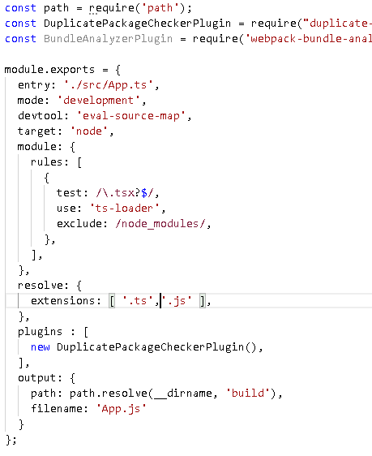
MEN Stack
Configurations
module
third party extensions to parse different file types
output
compiled directory
Plugins
add additional feature in the bundling process

Slide 15
MEN Stack
Some plugins we will be using throughout this short course
sass-loader
ts-loader
webpack-bundle-analyzer
duplicate-package-checker-webpack-plugin
…. check repo
https://webpack.js.org/plugins/

Slide 16
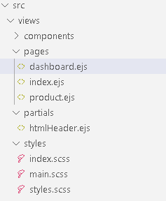
MEN Stack - EJS
Express HTML templating
We will be focusing on ‘EJS’
‘EJS’ is parsed by the engine to generate the desired HTML
Templating engine encourages code resuse

Slide 17
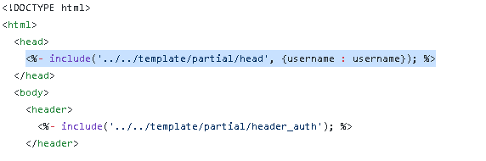
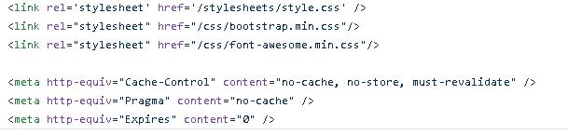
MEN Stack - EJS
partial html
partial html variables
partial html

Slide 18
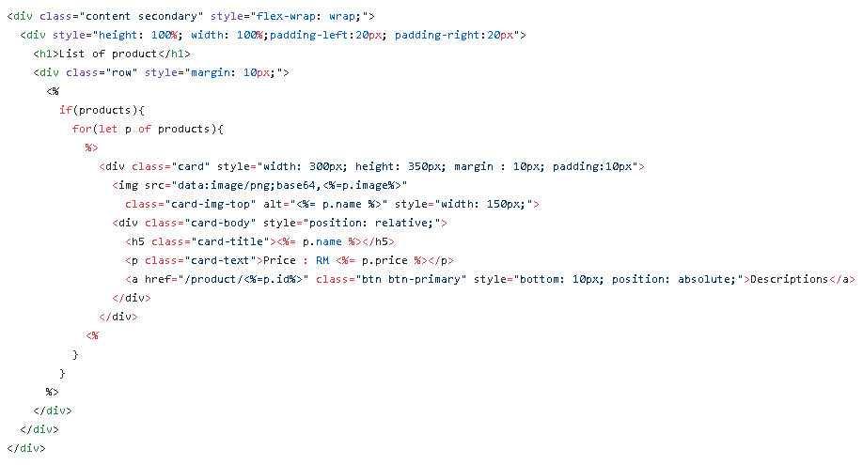
MEN Stack - EJS
Generate HTML
Logic

Slide 19
MEN Stack – EJS
SASS – A CSS preprocessor
Supports
Variables
Nested Syntax
Support mixins
Support partial files ( modularizing css)
Support inheritance

Slide 20
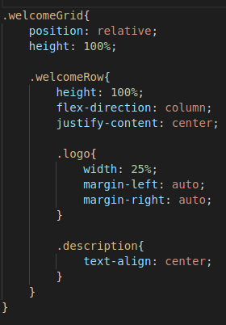
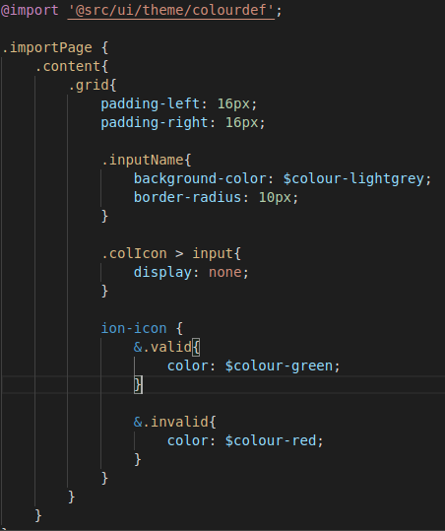
MEN Stack – EJS
SASS Nested
SASS Variables

Slide 21
MEN Stack – EJS
DEMO
P3

Slide 22
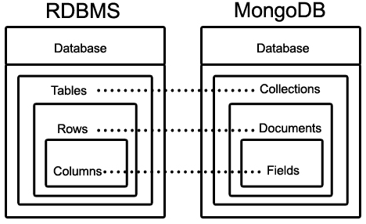
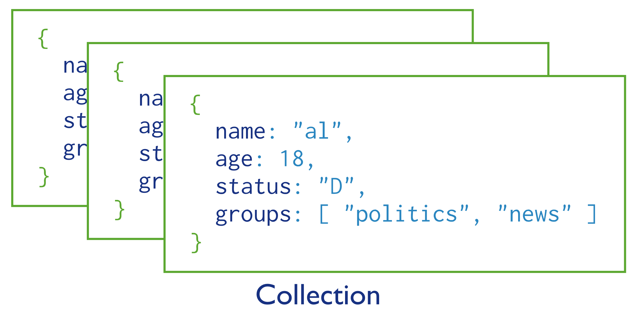
MEN Stack - MongoDB
MongoDB is a NoSQL database a.k.a non-relational databases

Slide 23
MEN Stack - MongoDB
Installation for community edition
https://docs.mongodb.com/manual/administration/install-community/
Official Node MongoDB driver
https://www.npmjs.com/package/mongodb
Good to have:
MongoDB Compass – GUI / Visualisation tool
MongoDB Tools – Management scripts

Slide 24
MEN Stack - MongoDB
Retrieval Basics
find()
findOne()
Others operations available:
const findResult = await orders.find({
name: "Product 1",
});
const findResult = await orders.findOne({
price: {$gt : 100}
});
const findResult = await orders.find()
.sort({name : -1})
.limit(10);

Slide 25
MEN Stack - MongoDB
Query Operators
Name | Description
$eq | Matches values that are equal to a specified value.
$gt | Matches values that are greater than a specified value.
$gte | Matches values that are greater than or equal to a specified value.
$in | Matches any of the values specified in an array.
$lt | Matches values that are less than a specified value.
$lte | Matches values that are less than or equal to a specified value.
$ne | Matches all values that are not equal to a specified value.
$nin | Matches none of the values specified in an array.

Slide 26
MEN Stack - MongoDB
Write Basics
insert()
insertMany()
delete()
deleteMany()
updateOne()
const product = {
name: "Product 1",
description: "Best product ever"
};
const result = await productCol.insertOne(product);
const result = await productCol.deleteOne({
name: "Product 1“
});

Slide 27
MEN Stack - MongoDB
Write Basics
updateOne()
const result = await productCol.updateOne(
{ name : "Product 1"},
$set : { name : "Product 2"}
);
Filter
Update
Name | Description
$inc | Increments the value of the field by the specified amount.
$min | Only updates the field if the specified value is less than the existing field value.
$max | Only updates the field if the specified value is greater than the existing field value.
$mul | Multiplies the value of the field by the specified amount.
$rename | Renames a field.
$set | Sets the value of a field in a document.
$unset | Removes the specified field from a document.

Slide 28
MEN Stack - MongoDB
‘Join’ operations can be done via `aggregate` and `lookup`
User
{
_id: ObjectId("60fa8971ee5e2ae8f26fe069"),
type: "user",
name: "Marcelina Grant",
},
Basket
{
type: "basket",
basketNo: 1,
userId: ObjectId("60fa8971ee5e2ae8f26fe069"),
pid: ObjectId("60fa8c398e22cddb65ba26ba"),
quantity: 2
},
{
type: "basket",
basketNo: 1,
userId: ObjectId("60fa8971ee5e2ae8f26fe069"),
pid: ObjectId("60fa8beccda8ce782fdab6ec"),
quantity: 1
}

Slide 29
MEN Stack - MongoDB
Get a basket and query the product, quantity & user details
db.raw.aggregate([
{ $match : {type : 'basket', userId: ObjectId("60fa8971ee5e2ae8f26fe069"), basketNo : 1 } },
{ $lookup:
{
from: 'raw',
localField: 'userId',
foreignField: '_id',
as: 'userDetails'
}
},
{ $unwind : '$pid' },
{ $unwind : '$quantity' },
{ $unwind : '$userDetails' },
{ $group : {
_id: ObjectId(),
basket : { $push: { pid : '$pid' , quantity : '$quantity' }},
user: { $first : '$userDetails' }
}}
])

Slide 30
MEN Stack - MongoDB
Get a basket and query the product, quantity & user details
Get Relevant Basket
db.raw.aggregate([
{ $match : {type : 'basket', userId: ObjectId("60fa8971ee5e2ae8f26fe069"), basketNo : 1 } },
{ $lookup:
{
from: 'raw',
localField: 'userId',
foreignField: '_id',
as: 'userDetails'
}
},
{ $unwind : '$pid' },
{ $unwind : '$quantity' },
{ $unwind : '$userDetails' },
{ $group : {
_id: ObjectId(),
basket : { $push: { pid : '$pid' , quantity : '$quantity' }},
user: { $first : '$userDetails' }
}}
])

Slide 31
MEN Stack - MongoDB
Get a basket and query the product, quantity & user details
db.raw.aggregate([
{ $match : {type : 'basket', userId: ObjectId("60fa8971ee5e2ae8f26fe069"), basketNo : 1 } },
{ $lookup:
{
from: 'raw',
localField: 'userId',
foreignField: '_id',
as: 'userDetails'
}
},
{ $unwind : '$pid' },
{ $unwind : '$quantity' },
{ $unwind : '$userDetails' },
{ $group : {
_id: ObjectId(),
basket : { $push: { pid : '$pid' , quantity : '$quantity' }},
user: { $first : '$userDetails' }
}}
])
Get Relevant Basket
`Join` user into basket
{
basket:1
pid : …,
quantity : …
userDetails:…
},
{
basket:1
…
}

Slide 32
MEN Stack - MongoDB
Get a basket and query the product, quantity & user details
db.raw.aggregate([
{ $match : {type : 'basket', userId: ObjectId("60fa8971ee5e2ae8f26fe069"), basketNo : 1 } },
{ $lookup:
{
from: 'raw',
localField: 'userId',
foreignField: '_id',
as: 'userDetails'
}
},
{ $unwind : '$pid' },
{ $unwind : '$quantity' },
{ $unwind : '$userDetails' },
{ $group : {
_id: ObjectId(),
basket : { $push: { pid : '$pid' , quantity : '$quantity' }},
user: { $first : '$userDetails' }
}}
])
Get Relevant Basket
`Join` user into basket
{
basket:1
pid : …,
quantity : …
userDetails:…
},
{
basket:1
…
}
Extract `pid`, `quantity`, `userDetails`

Slide 33
MEN Stack - MongoDB
Get a basket and query the product, quantity & user details
{
_id: ObjectId("60faad8b6c2ef9b5755bb4b9"),
basket: [
{ pid: ObjectId("60fa8c398e22cddb65ba26ba"), quantity: 2 },
{ pid: ObjectId("60fa8beccda8ce782fdab6ec"), quantity: 1 } ],
user: { _id: ObjectId("60fa8971ee5e2ae8f26fe069"),
type: 'user',
name: 'Marcelina Grant',
}
}
db.raw.aggregate([
{ $match : {type : 'basket', userId: ObjectId("60fa8971ee5e2ae8f26fe069"), basketNo : 1 } },
{ $lookup:
{
from: 'raw',
localField: 'userId',
foreignField: '_id',
as: 'userDetails'
}
},
{ $unwind : '$pid' },
{ $unwind : '$quantity' },
{ $unwind : '$userDetails' },
{ $group : {
_id: ObjectId(),
basket : { $push: { pid : '$pid' , quantity : '$quantity' }},
user: { $first : '$userDetails' }
}}
])
Get Relevant Basket
`Join` user into basket
Extract `pid`, `quantity`, `userDetails`
Group into a document

Slide 34
MEN Stack – Demo
DEMO
P4

Slide 35
MERN Stack
MEN Framework Stack – MongoDB + Express + Node
MongoDB – The standard NoSQL database
Express – The default web applications framework
React – UI framework
Node.js – Framework used for scalable server-side and networking applications.
Single Page Application (SPA) framework

Slide 36
MERN Stack
React UI
Framework
Node
Express JS Framework
Communication
Protocol
Fetch
Socket.IO
MongoDB
Router
Router
Component
Controller
Services
Object Document Mapper

Slide 37
MERN Stack – React
React is a declarative, JavaScript library for building user interfaces
Built on virtual DOM
Update only elements requires changing
React implements one-way reactive data flow, which reduces the boilerplate and is easier to reason about than traditional data binding.

Slide 38
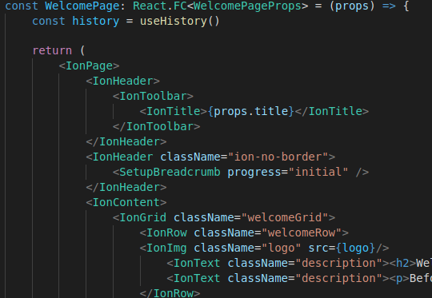
MERN Stack – React
React JSX / TSX files write html elements in JavaScript

Slide 39
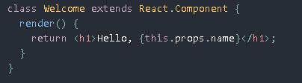

MERN Stack – React
React functional components and class components
Functional components manages states using hooks
Class components manages states using class variables
Class components have better control over their lifecycle

Slide 40
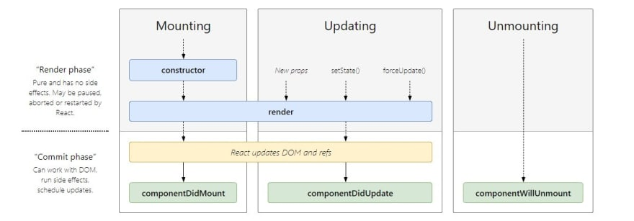
MERN Stack – React
React Functional component promises optimisations
React hooks enable states without class components
useState
useEffect

Slide 41
MERN Stack – React Routing
React supports declarative routing
useParam / useLocation hook can be used to access url param
<BrowserRouter>
<Switch>
<Route path="/about">
<About />
</Route>
<Route path="/users">
<Users />
</Route>
<Route path="/">
<Home />
</Route>
</Switch>
</BrowserRouter>
Current Route
Component to route to

Slide 42
MERN Stack – Demo
DEMO
P5

Slide 43
MERN Stack – React
React components
View
Search : Text
Input : Text
Input : Text

Slide 44
MERN Stack – React
Inter-component communication
View
Data binding
Search : Text
Input : Text
Data binding
Input : Text

Slide 45
MERN Stack – React
React-redux simplifies inter-component communication
React Redux
View
Search : Text
Input : Text
Input : Text

Slide 46
MERN Stack – React
React-redux
We will focus on ‘@reduxjs/toolkit’
Opinionated toolkit for generating redux code
But extremely simple to use

Slide 47
MERN Stack – React
Redux Terminology
Action – intention to change a state
Reducer – converts action into a new state
Dispatch – dispatch action and triggers state
Store – immutable state container
Provider – expose store
Dispatch
Action
Reducer
Store
View
Provider

Slide 48
Framework Stack – MERN Stack
DEMO
P6

Slide 49
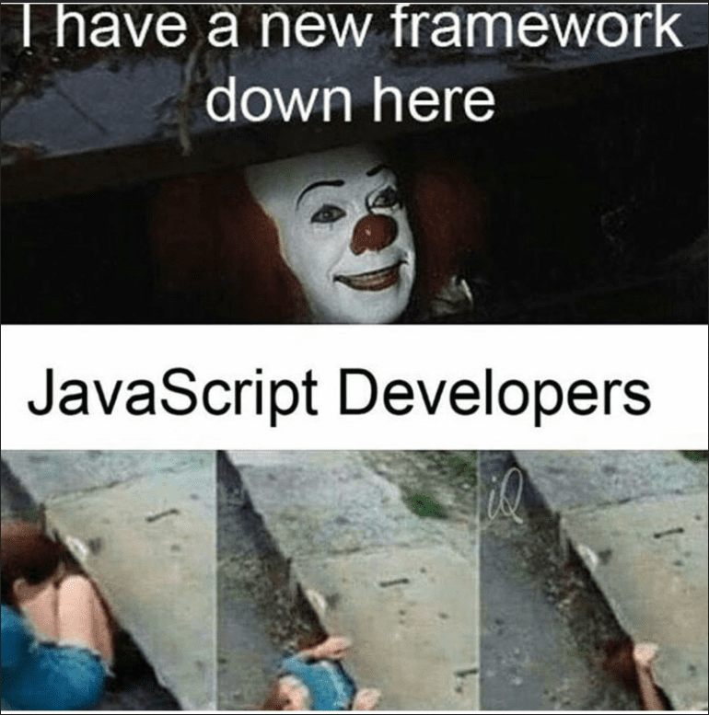
Framework Stack
No such thing as the best stack combo
Find one.
Git gud.
Develop the app.

